Slide 1
Cataloging and Indexing

Slide 2
Introduction
Indexing: Indexing is the process of converting an item (such as a document or data entry) into a searchable data structure.
This process can be done manually by a person or automatically by software, creating the basis for direct search of items in the Document Database or indirect search via Index Files.
Some systems transform items into a concept-based representation rather than a direct textual representation.

Slide 3
Introduction
Information extraction is closely associated with the indexing process.
Goal: To extract specific information to be normalized and entered into a structured database (DBMS)
Normalization: The extracted information is modified to fit into a structured database management system (DBMS).
Information extraction differs because it focuses on very specific concepts and contains a transformation process that modifies the extracted information into a form compatible with the end structured database. This process is referred as Automatic file Build.

Slide 4
History of Indexing
Indexing (originally called Cataloging) is the oldest technique for identifying the contents of items to assist in their retrieval.
Encouraging users to access item contents in an efficient way has always been the primary objective of indexing.
In pre-19th Century cataloging methods evolved slowly. Early cataloging was straightforward, focusing on organizing information with basic bibliographic details.

Slide 5
History of Indexing
In 19th Century the system became more sophisticated with the introduction of hierarchical methods like the Dewey Decimal System, which organizes subjects into a hierarchical structure.
In 1960s the Library of Congress began exploring computerization for cataloging. The MARC (MAchine Readable Cataloging) standard was developed to create a standardized format for bibliographic records, facilitating the sharing and electronic management of catalog data.
In 1965 DIALOG System was Developed by Lockheed for NASA and commercialized in 1978, DIALOG was one of the earliest commercial indexing systems, offering a vast number of databases to users globally.

Slide 6
Objectives of Indexing
The evolution of Information Retrieval (IR) systems has significantly impacted the objectives and methods of indexing.
When an item's entire text becomes searchable, objectives that were previously used to establish manual indexing rules are no longer applicable.
Total document indexing is a new type of indexing made possible by the full text searchable data format for Document File elements.
[With the advent of digital documents, systems can now index and search the entire text of a document. This method, known as total document indexing, treats all words in a document as potential index terms.]

Slide 7
Objectives of Indexing
The process of item normalization involves converting all possible words into processing tokens—units used to represent the document’s content in a searchable format.
Modern systems have the ability to automatically weigh the processing tokens based on their importance.
Despite full-text search capabilities, manual indexing still has value.
While automated systems can search all words, manual indexing involves selecting and abstracting key concepts, adding value by providing context and relevance that automated systems might miss.

Slide 8
Objectives of Indexing
Two types of index files:
Public Index Files: These are broad and include more general terms applicable to a wide audience. They enhance search recall by covering a wide range of concepts.
Private Index Files: These are user-specific and contain more focused, relevant terms based on individual needs. They improve search precision by filtering information to match the user’s specific interests.

Slide 9
Objectives of Indexing
Electronic indexes support additional functionalities like ranking search results by relevance and clustering items by concepts.
This helps users find the most relevant information more efficiently, similar to browsing in a physical library.
The system adapts to user needs by combining public and private indexing methods, allowing users to customize their searches and manage information more effectively.

Slide 10
Indexing Process
When an organization with multiple indexers is setting up public or private indexes, some procedural decisions about how to build the index terms are required.
This help the indexers and end users know what to expect in the index file.
Two key procedural decisions are:
scope of the indexing: The scope of indexing refers to the level of detail and breadth of coverage that the subject index will include.
Linking Index Terms: Linking index terms involves connecting related terms or concepts within a single index to facilitate better navigation and understanding of the subject matter. This decision determines how index terms will be organized and interrelated.

Slide 11
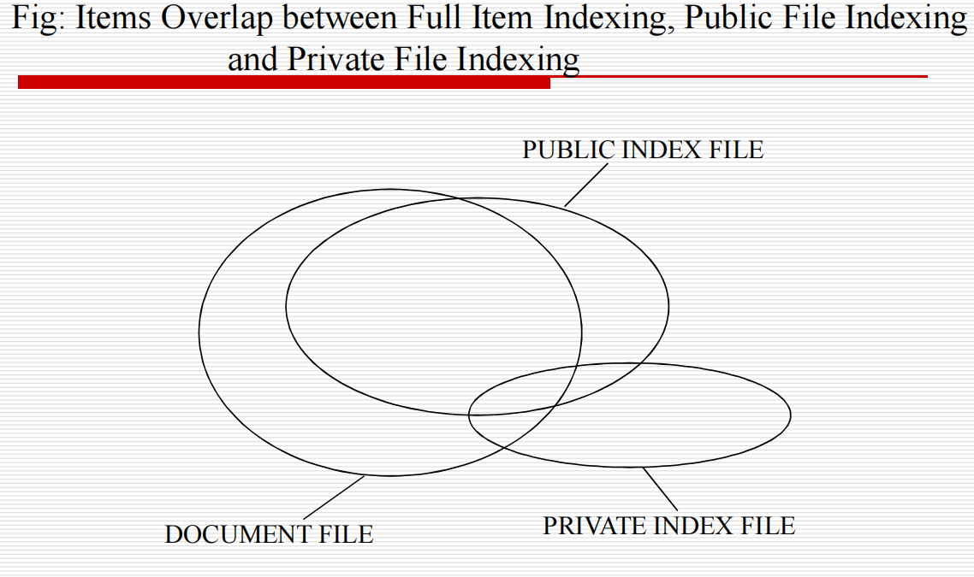
Indexing Process

Slide 12
Scope of Indexing
Finding the bibliographic phrases that accurately and consistently describe the ideas in an item is a very challenging task when done by hand. Interaction between the author and the indexer can lead to issues.
Authors use their own specialized terms and language based on their field of expertise. For instance, a medical researcher might use technical terms specific to their field that are not widely known outside of it.
Indexers may have a different set of terms or less familiarity with the author’s specific vocabulary. If an indexer doesn’t understand or recognize the author’s specialized terminology, they might misinterpret the content or choose less accurate index terms.
For example:
Author uses the term “myocardial infarction” to describe a heart attack.
Indexer might not be familiar with this term and choose a more general term like “heart disease” instead. This could lead to less precise indexing of the document.
Authors are often experts in their subject matter, and their writing might include complex, nuanced discussions that reflect deep knowledge.
Indexers might not have the same level of expertise in the specific subject area. They might not fully grasp the significance or the context of certain concepts, which can affect the accuracy and depth of the indexing.
Indexers need to decide when to stop adding terms to the index.
This decision involves balancing thoroughness with practical constraints like time and cost.

Slide 13
Scope of Indexing
Selecting the appropriate indexing level for an item's concepts depends on two criteria:
Exhaustivity: This relates to the extent to which certain concepts within the document are fully indexed.
For example, in a lengthy document on microprocessors, if only a small section discusses a specific aspect like “on-board caches,” the indexer must decide if this should be included or not.
Specificity: This refers to how detailed or precise the index terms are.
For instance, deciding whether to use “processor,” “microcomputer,” or a specific model like “Pentium” depends on how specific the index should be.
High specificity involves using very precise terms, while low specificity uses more general terms.

Slide 14
Scope of Indexing
Low Exhaustivity and Specificity:If only the most important concepts are indexed with general terms, it simplifies the indexing process and reduces costs but may lead to less detailed searches and lower precision in retrieving specific information.
High Exhaustivity and Specificity: This approach involves indexing nearly every relevant concept with detailed terms, making the index more comprehensive. For example, a detailed index (for the paragraph in the Kowalski text book) might include terms like “indexing,” “indexer knowledge,” “exhaustivity,” and “specificity” for a given document.

Slide 15
Scope of Indexing
Another decision on indexing is what portions of an item should be indexed.
The simplest case is to limit the indexing to the Title or Title and Abstract zones.
This method reduces the cost and effort but might miss important details, affecting the index’s effectiveness.
Weighting of index terms is not common in manual indexing systems.
Weighting of index terms involves assigning a level of importance to different terms based on how much they are discussed in a document.

Slide 16
Scope of Indexing
Example for Weighting of index terms :
Imagine you are indexing a research paper on "Artificial Intelligence in Healthcare". The paper covers various topics such as:
Machine Learning Algorithms
Healthcare Data Security
Medical Imaging Techniques
Patient Privacy Issues
Without Weighting:
Artificial Intelligence
Healthcare Data Security
Medical Imaging Techniques
Patient Privacy Issues
In this scenario, each term is treated equally, regardless of how extensively or prominently it is covered in the document. This means that if the paper spends a lot of time on "Machine Learning Algorithms" but only briefly mentions "Patient Privacy Issues," both terms will be listed in the index with equal prominence.

Slide 17
Scope of Indexing
With Weighting:
When using weighting, you assign levels of importance to index terms based on their prominence in the paper. For instance:
Machine Learning Algorithms (Weight: 5)
Healthcare Data Security (Weight: 3)
Medical Imaging Techniques (Weight: 2)
Patient Privacy Issues (Weight: 1)
Here’s how you might determine these weights:
Machine Learning Algorithms (Weight: 5): The paper extensively discusses various algorithms, providing detailed analysis and numerous examples. This term is given a high weight because it’s a central topic.
Healthcare Data Security (Weight: 3): There is significant discussion on this topic, but it's not as central as machine learning. It’s important but secondary.
Medical Imaging Techniques (Weight: 2): This topic is mentioned, but only briefly. It’s relevant but not a major focus.
Patient Privacy Issues (Weight: 1): This is a minor point discussed briefly. It’s the least emphasized topic in the paper.
Benefits of Weighting:
Improved Precision: Users searching for in-depth information on "Machine Learning Algorithms" will easily find the relevant sections because this term is given a higher weight.
Enhanced Relevance: Weighting helps in presenting the most relevant terms more prominently, making searches more effective.
Efficient Retrieval: Users can quickly locate major themes and important sections of the document based on the weighted index terms.

Slide 18
Scope of Indexing
Implementing weighting requires additional effort in terms of assigning and managing weights, which complicates the indexing process.
Storing and retrieving weighted terms requires more sophisticated data structures, increasing the complexity of the indexing system.

Slide 19
Precoordination and Linkages
Linkages refer to connections made between index terms to show relationships or attributes.
For example, if you're indexing a document about oil drilling in Mexico, linkages might connect terms like "Mexico" and "oil drilling.“
When related terms are linked together at index creation time then it is called precoordination.
This means the relationships between terms are set in advance.
When index terms are not coordinated at index time, the coordination occurs at search time. This is called postcoordination, that is coordinating terms after (post) the indexing process.
Postcoordination is implemented by “AND”ing index terms together, which only finds indexes that have all of the search term

Slide 20
Precoordination and Linkages
Factors (elements) that must be determined in the linkage process are:
Number of Terms: Determines how many terms can be linked together.
Any Ordering Constraints on the linked terms: Defines if the order of terms matters. For instance, if the sequence "Mexico – oil drilling" is different from "oil drilling – Mexico.“
Any Additional Descriptors are associated with index terms: Additional information that describes the role of each term.
Example: Suppose you are indexing a document about "CITGO’s oil drilling in Mexico affecting local communities." Here’s how you could use descriptors:
"CITGO (Source) – oil drilling (Activity) – Mexico (Location).“
The descriptors clarify the role of each term, allowing users to search for documents where CITGO is performing oil drilling activities in Mexico.

Slide 21
Precoordination and Linkages
When multiple terms are being used, the possibility exists to have relationships between the terms.
Each term has to be qualified with one of these three categories and linked to another term to illustrate how the relationships between the terms describe a single semantic concept.
order of the terms
Positional Roles
Modifiers

Slide 22
Precoordination and Linkages
order of the terms: When linking terms, ordering can be used to provide additional context.
For instance, "CITGO – oil drilling – Mexico" might imply that CITGO is drilling oil in Mexico.
Positional Roles refer to a technique where the position of terms in an index entry implicitly defines their roles or relationships. The position of each term within a sequence indicates its function or significance in relation to other terms.
In a sequence like "U.S. – oil refineries – Peru," each term occupies a specific position:
"U.S." is in the first position.
"oil refineries" is in the second position.
"Peru" is in the third position.
The roles are assigned based on the predefined positions. For instance, the first position might always represent the source, the second position the activity, and the third position the location.
If the sequence has a fixed number of positions and you need to include additional details, you may face limitations. For instance, if you want to add more roles, such as the impact or timeframe, the fixed positions may not accommodate these additional details without causing ambiguity.

Slide 23
Precoordination and Linkages
Modifiers: Instead of using positional roles, modifiers allow for a more flexible approach. One entry could list multiple countries with corresponding modifiers, reducing the need for multiple separate entries.
Example: Suppose you are indexing a document about "U.S. introducing oil refineries into Peru, Bolivia, and Argentina.“
Using positional roles, you would have multiple separate entries to cover each location:
"U.S. – oil refineries – Peru”
"U.S. – oil refineries – Bolivia"
"U.S. – oil refineries – Argentina“
With modifiers, you can create a single entry that lists all the countries with their respective roles:
"U.S. – oil refineries – Peru (affected country) – Bolivia (affected country) – Argentina (affected country)“
Here, "affected country" is the modifier applied to each location to indicate their role in the context of the oil refineries.
If the document also mentions the impact of the oil refineries, you could add:
“U.S. – oil refineries – Peru (affected country, economic impact) – Bolivia (affected country, economic impact) – Argentina (affected country, economic impact)"

Slide 24
AUTOMATIC INDEXING
Automatic indexing refers to a system’s ability to automatically select index terms for an item (e.g., a document) without human intervention.
This contrasts with human indexing, where a person manually determines the index terms based on their understanding.
Simple Indexing uses every word in the document as an index term (total document indexing).
Complex Indexing is required when the objective is to imitate a human indexer and determine a limited number of index terms for the major concepts in the item.

Slide 25
AUTOMATIC INDEXING
Advantages of Automatic Indexing:
Cost Efficiency: After initial hardware costs, the ongoing costs are minimal compared to salaries for human indexers.
Processing Speed: Automatic indexing is much faster, taking only a few seconds compared to the several minutes a human indexer might need for each document.
Consistency: Algorithms used in automatic indexing provide consistent results, whereas human indexers may produce varying results for the same document. For instance, in TREC-2 experiments, different judges had about a 20% discrepancy in indexing the same documents.

Slide 26
AUTOMATIC INDEXING
Advantage of Human Indexing: The ability to determine concept abstraction and judge the value of a concept.
Concept Abstraction: Understanding and expressing a document's fundamental ideas or themes outside of its actual text is known as concept abstraction.
Identify Broader Themes: For example, a human indexer can recognize that a document discussing various aspects of "climate change" might be relevant to a broader category of "environmental issues.“
Contextual Understanding: They can interpret the context in which terms are used. For example, the term "bank" could refer to a financial institution or the side of a river, and human indexers can use contextual clues to determine which meaning is relevant.
Judgment of Concept Value: Judgment of concept value involves assessing the importance or relevance of different concepts within a document.
Human indexers can prioritize concepts based on their relevance to the intended audience or user needs. For instance, in a medical document, they might highlight terms related to treatment over those related to general symptoms.

Slide 27
AUTOMATIC INDEXING
Indexes resulting from automated indexing fall into two classes:
Weighted: Assigns weights to index terms based on their frequency in the document, reflecting their importance. Higher weights indicate a stronger representation of a concept. This method often uses normalized values and allows for ranking search results based on their relevance.
Unweighted: Only records the presence (and sometimes location) of index terms without differentiating their significance. Early systems often used this method, and all indexed items are treated equally in searches.
Concept Indexing: Instead of directly indexing the original text, this method maps the document into a different representation based on concepts. The final index values are derived from these concepts.

Slide 28
AUTOMATIC INDEXING
Research and Theoretical Background:
Luhn’s Resolving Power: Luhn suggested that the importance of a term is proportional to its frequency in the document.
Distribution of Terms: Studies by Brookstein, Klein, and Raita found that important terms often cluster together rather than being evenly distributed.

